Slide 1
Game CO Sales Analysis
Prepared by Kareemah Ashiru

Slide 2
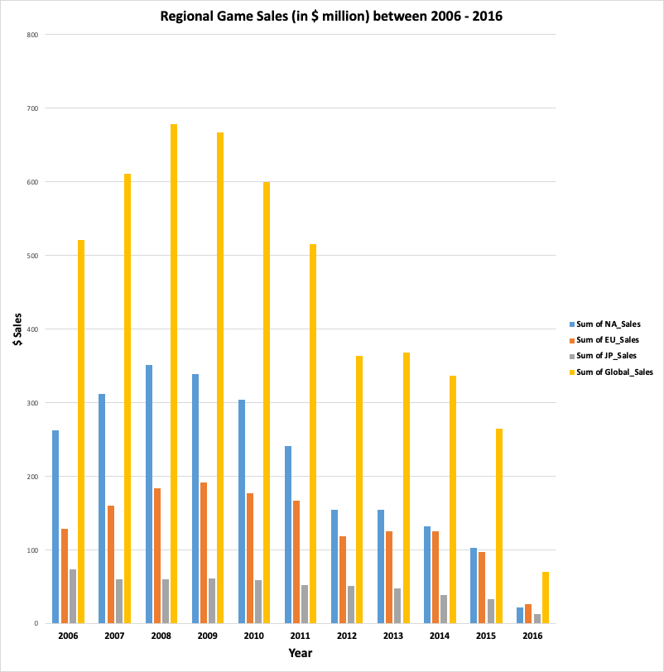
Game Co’s Sales Data from 2006 - 2016
ShareCo’s current understanding assumes that game sales for the various geographic regions (North America, Europe, Japan, and the Globe) have stayed the same over time.
Data on ShareCo regional game sales from 2006 - 2016 from North America (NA), Europe (EU), Japan (JP), and the Globe.
.
Figure 1
The data suggests that game sales have fluctuated over time. This contrasts with our current understanding of our business.

Slide 3
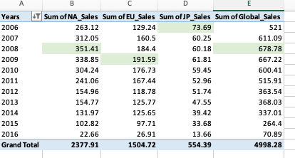
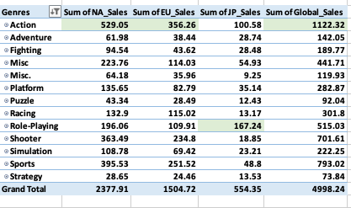
Sales Breakdown
In the last decade, North America ($2,378) led sales, followed by Europe ($1,505), and then Japan ($554). [See figure 2].
Figure 2 further highlights which year had the most success per region.
In figure 3 we can see the sum of regional sales in the last 10 years grouped by game genres.
Action games led NA ($529.05), EU sales ($356.26) and Global Sales ($1,122.32), Role-Playing games led JP sales (167.24).
Total sales by genre [in figure 3] matches the grand total sales over the years as seen in figure 2.
Figure 2
Figure 3

Slide 4
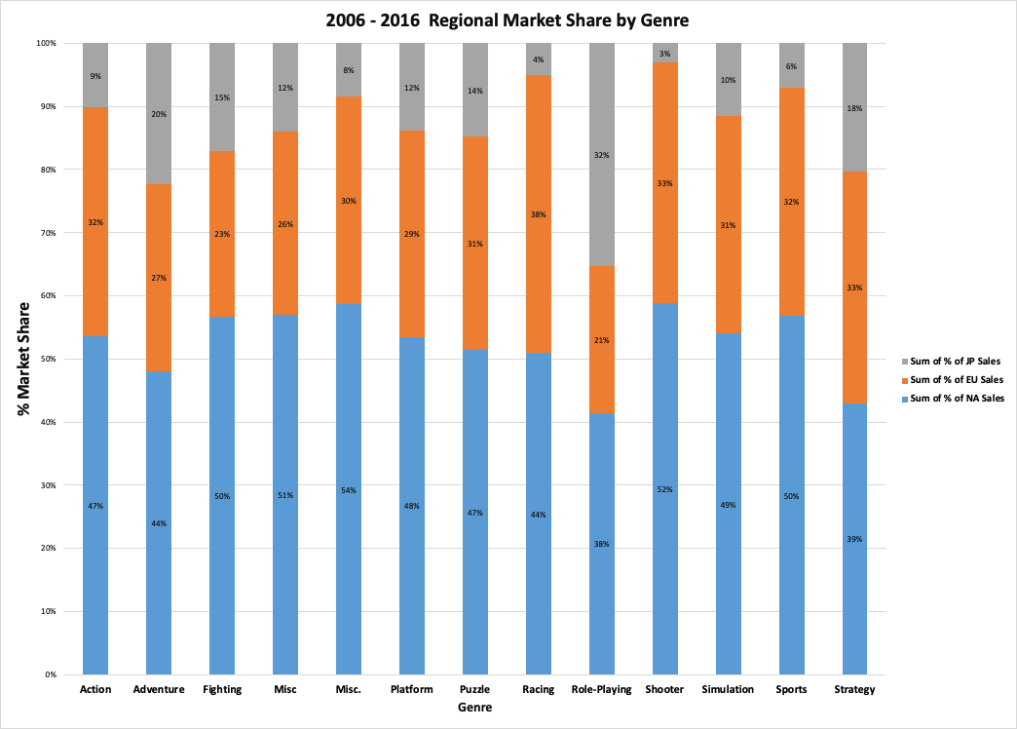
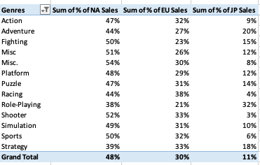
Regional Market Share in the last 10 years
In the last 10 years Misc (54%) and Shooter (52%) games rank the highest for North America, Shooter (33%) and Strategy(33%) games rank the highest for Europe, Role Playing (32%) rank the highest for Japan. See figure 4.
Across all genres, NA Sales holds most of the market share at 48% followed by EU Sales 30% and then JP Sales 11%. See figure 5.
Figure 4
Figure 5

Slide 5
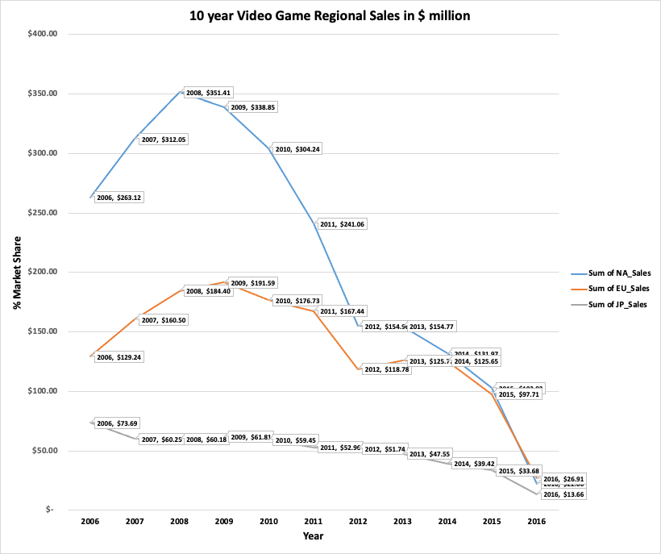
10 Year Trend
According to figure 6 on the left, NA experienced it’s highest sales in 2008 at $351.41. For EU it was a year after in 2009 at $191.59. JP’s peak was in 2006 at $73.69.
It appears from the graph in figure 6 that sales in all regions have drastically declined since 2008.
In summary, this 10 year graph and findings from slide 2 - 4 challenge GameCo’s assumption that sales have been steady over the years. The fluctuations between 2006 - 2016 support the data provided.
Figure 6

Slide 6
Recommendation
Allocate most of the marketing budget to the North American region to get the best ROI since it makes up of 48% of the global market.
About 30% of the budget should go to Europe and the rest can go to Japan.
For Japan, Invest heavily in Role-Playing games.
Action and Shooter games can become a new genre group. This will help the marketing team focus on this genre for both North America and Europe.
Further analysis could be done into what comprises of the Miscellaneous genre, there seems to be an untapped market there as seen in slide 4, figure 4.
This year, the commonly used gaming platforms were 3DS, PC, PS3m PS4, PSV, WiiU, X360, and XOne. We can continue to sell games using the platforms listed.
Japan saw it’s highest sales in 2006 during Shinzo Abe’s election win. Election season is coming up next year in Japan [BBC], perhaps this could positively influence the country’s game sales.
U.S. election results in November will influence the economy and in turn North America and Global game sales in 2017 [On this day].

Slide 7
Glossary
NA - North America
EU- Europe
JP- Japan
ROI- Return on Investment
$ Sales - Sales in US millions dollars
%- Percentage
Decade- 10 years

Slide 8
Resources
BBC’s Japan Profile
World Events in 2016
Careerfoundry Data Co.

